Slide 1
E-Commerce Cohort Retention & Customer Lifetime Value Analysis Understanding Customer Retention, Churn Patterns & Lifetime Value through Cohort and Retenion Analytics
Internship Project
Prepared by : Yusuf Bahrainwala
Project Domain : E-commerce Cohort Retention and CLTV Analysis
Tools Stack : Python ( pandas, numpy, matplolib ), DAX, PowerBI, GitHub

Slide 2
Executive Problem Statement
Business Challenge
Project Goal
Acquiring new customers is significantly more expensive than retaining existing ones. While many businesses focus on customer acquisition, they often overlook how long customers stay engaged and how much value they generate over time. Without understanding customer retention and lifetime value, organizations risk increasing acquisition costs while experiencing declining profitability.
This project applies Cohort Analysis and Customer Lifetime Value (CLTV) Analysis to evaluate customer behavior after acquisition. By grouping customers based on their first purchase month, the analysis identifies retention trends, measures customer value, and uncovers opportunities to improve long-term business growth.

Slide 3
Dataset Overview
Tables used
Aspect | Details
Data Type | E-commerce Transactional Data
Analysis Period | Oct 2016 - Aug 2018
Granularity | Indivisual Customer Transactions
Key Entity | Customer
Core Measures | Revenue, Orders, Customers
Customer Analysis | Cohort, Retention, Segemnt, CLTV
Olist customers dataset
Olist order items
Olist order payments
Olist Orders dataset
Olist products
Product category name
Key Metrics Derived
Historical CLTV
Purchase Frequency
Average Order Value
Customer Segmentation
Cohort Months
Retention Rate
Total Revenue, Customers, Orders

Slide 4
When and how quickly do customers churn after acquisition?
01
What purchasing behaviors drive higher customer value?
02
Business Questions Answered
Which customer cohorts have the strongest retention?
03
Which products and customer segments contribute most to revenue and value?
04
Which customer segments generate the highest CLTV?
05

Slide 5
Analytical Pipeline
Data Cleaning and Data Pre-processing
Cohort, Segmentation & CLTV Analysis
step 01
step 02
step 03
step 04
step 05
Raw Ecommerce Transactional Data Collection
Feature Engineering and Exploratory Data Analysis
Report and Dashboard Creation

Slide 6
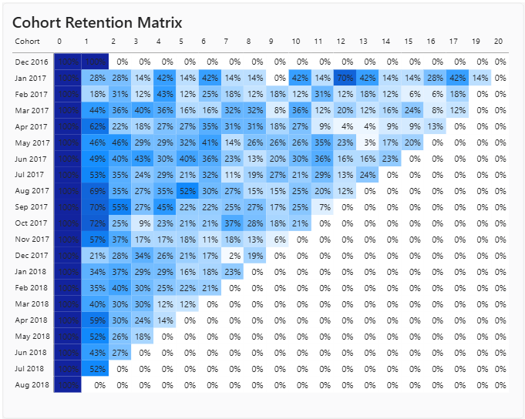
Cohort Retention Matrix
Objective: Understand how customer retention changes after the first purchase and identify major drop-off points.
Key Metrics to Highlight
Month 0: Initial customer cohort
Month 1, Month 2, ...: Subsequent customer activity
Retention %: Percentage of the original cohort remaining active
Key Insight
Customer retention declines sharply after the initial purchase, with the largest customer drop-off occurring in the early months following acquisition.
Business Implication
Early post-purchase engagement is critical. Targeted re-engagement campaigns during the first few months could help reduce customer churn.

Slide 7
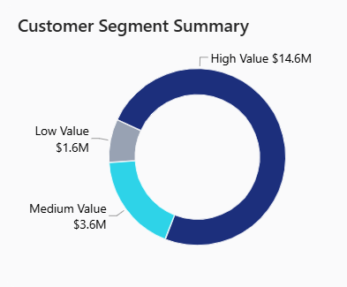
Customer Value Segmentation
Objective: Identify high-value, medium, and low-value customers based on their purchasing behavior and CLTV.
Segmentation
Customers from the data where segemented in High, Medium and Low categories based on their Historical CLTV using pd.qcut() function in Python where each category had around 31k customers.
Key Insight
High-value customers represent a similar-sized customer group but generate substantially greater customer value than the lower-value segments.
Business Implication
High-value customers should be prioritized for retention initiatives, personalized offers, and Customer loyalty programs.

Slide 8
Customer Lifetime Value Analysis
Objective: Quantify the long-term economic value generated by each customer.
Key steps in calculating Historical CLTV :
Deriving Customer Level summary
Calculating customer lifespan
Calculating average order value for each customer
Calculating purchase frequency based on orders
Calculating Historical CLTV
Key Findings
CLTV varies substantially across customer segments.
Higher-value customers demonstrate stronger purchasing behavior.
AOV and purchase frequency are important contributors to customer value.
Business Implication
Increasing repeat purchases and extending customer lifespan can significantly improve customer lifetime value.

Slide 9
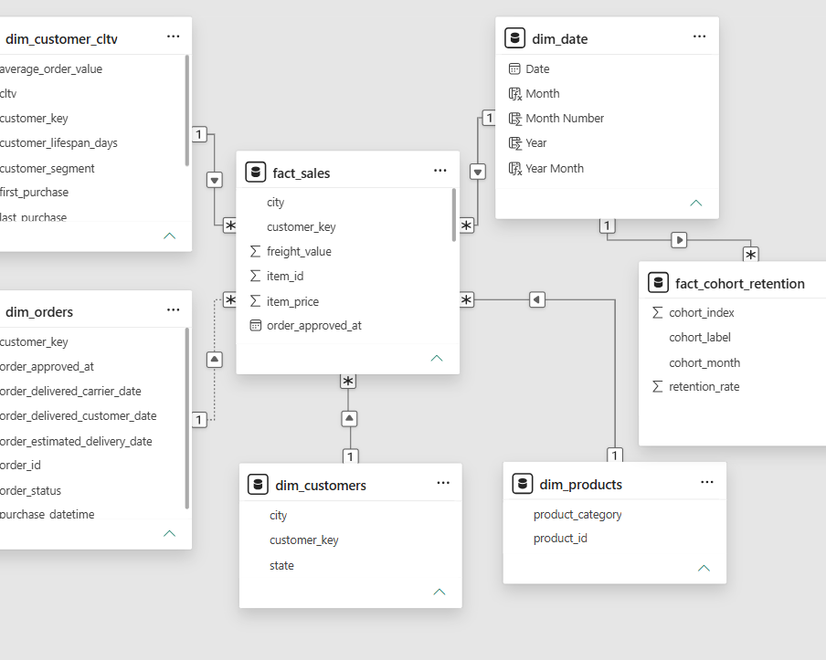
Data Modeling & Analytical Architecture
Objective: Building a structured data model that connects transactional data, customer data , cohort, and date information for reliable analysis and interactive reporting.
Fact Tables
fact_sales : transactional level sales data
fact_cohort_retention : customer cohort data
Dimension tables
dim_customers : customer attributes
dim_customer_cltv : customer-level CLTV metrics
dim_date : calendar/date analysis
dim_orders : order level data
dim_products : product Information
Relationships
One-to-many relationships connect dimension tables to the relevant fact tables, allowing filters such as customer segment, date, and cohort to flow into the analytical visuals.

Slide 10
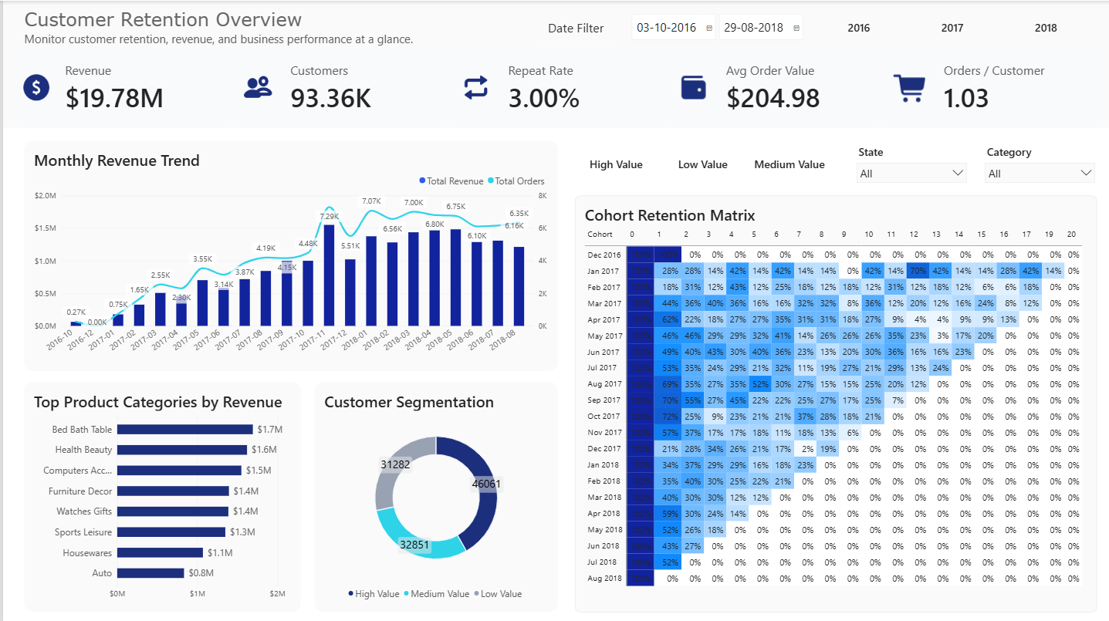
Customer Retention Overview Dashboard
Description : The dashboards contains key business kpi’s along with monthly revenue trend, cohort retention matrix, top product categories and customer segmentation chart.

Slide 11
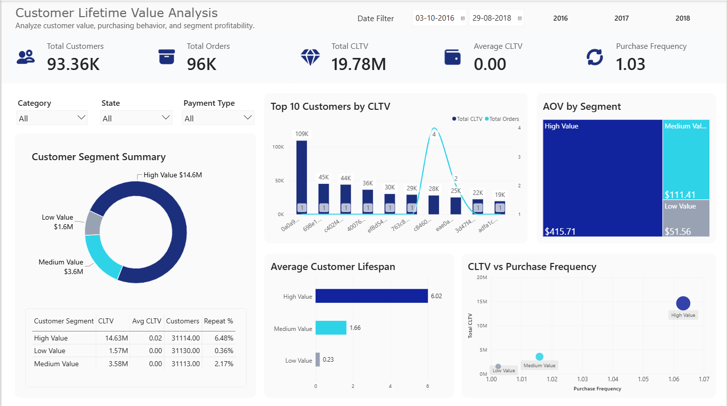
Customer Lifetime Value & Customer Segmentation
Description : The dashboards contains key CLTV kpi’s like Total CLTV, Avg CLTV and Purchase Frequency along with chart visuals like top customers, AOV by segment, AVG lifespan bar chart, CLTV vs Purchase Frequency distribution, Segmentation summary matrix etc.

Slide 12
Key Insights Derived
1. Revenue is strong, but repeat purchasing is low
The business generated $19.78M revenue from ~96K orders and 93.36K customers, yet the overall repeat rate is only 3% and orders/customer is just 1.03.
Insight: Revenue is being driven largely by first-time/low-frequency purchases rather than strong repeat behaviour.
2. High-value customers are the major revenue driver
The High Value segment contributes $14.63M CLTV, compared with $3.58M for Medium Value and $1.57M for Low Value.
Insight: High-value customers are important to business revenue and should receive the strongest retention and loyalty efforts.
3. Customer value differs dramatically across segments
High Value customers have an AOV of $415.71, versus $111.41 for Medium Value and only $51.56 for Low Value. Their average lifespan is also much longer (6.02 vs. 1.66 vs. 0.23).
Insight: Increasing customers' order value and keeping them active longer appears to be the key path to moving customers toward the High Value segment.

Slide 13
Key Insights Derived
4. Cohort retention declines sharply over time
The cohort matrix shows that customers generally experience a large drop in retention after their initial purchase, with many cohorts falling into low double-digit retention or below within subsequent periods.
Insight: The major challenge is not acquisition but converting first-time buyers into repeat customers.
5. Some cohorts demonstrate better retention than others
The cohort matrix shows noticeable differences between acquisition cohorts. For example, several 2017 cohorts maintain stronger retention in their early periods than others.
Insight: The business should investigate what acquisition channels, products, promotions, or customer experiences were associated with stronger cohorts and replicate those approaches.
6. Customer value is highly concentrated at the top
The Top 10 CLTV visual shows a very large gap between the highest-value customer (~$109K) and the remaining top customers, while the CLTV vs Purchase Frequency visual also shows the High Value segment clearly separated from Medium and Low Value customers.
Insight: A relatively small group of highly valuable customers contributes disproportionately to lifetime value, making VIP/loyalty programs and personalized retention strategies commercially important.

Slide 14
Business Recommendations
01
Strengthen Early Retention
Target new customers with personalized offers and follow-up campaigns during the first few months, where cohort retention drops sharply.
02
Build a High-Value Customer Program
Prioritize High Value customers with loyalty rewards, exclusive offers, and personalized communication to protect the $14.63M CLTV contribution.
03
Increase Repeat Purchases
With only a 3% repeat rate and 1.03 orders/customer, introduce post-purchase campaigns, replenishment reminders, and cross-selling strategies.
04
Increase Customer Value
Use bundles, cross-selling and premium recommendations to increase AOV, particularly by moving Medium Value customers toward the High Value segment.
05
Replicate High-Performing Cohorts
Identify the products, categories, acquisition periods, and customer characteristics associated with stronger-retaining cohorts and use them to improve future acquisition campaigns.

Slide 15
Conclusion and Key Takeaways
01 — Strong Revenue Base
The business generated $19.78M revenue, providing a strong foundation for customer-value growth.
02 — Retention is the Main Opportunity
The 3% repeat rate and declining cohort retention indicate that converting first-time customers into repeat buyers is a major challenge.
03 — High-Value Customers Drive CLTV
The High Value segment contributes $14.63M CLTV, with substantially higher AOV and customer lifespan than the other segments.
04 — Focus on Customer Lifetime Value
Improving retention, purchase frequency, customer lifespan, and AOV can increase long-term customer profitability.

Slide 16
Thank You
E-commerce Cohort Retention & CLTV Analytics Project

